Slide 1

Green Pace
Security Policy Presentation
Developer: Andrew Black

Slide 2

OVERVIEW: DEFENSE IN DEPTH
This security policy is to provide a set of guidelines for developers to write simple, clean, and secure solutions.

Slide 3
THREATS MATRIX
Each Secure Coding standard has a level of likeliness and prioritization.
Likely Threats that are likely to happen | Priority Highly prioritized standard
Low priority Less prioritized standard | Unlikely Threats that aren’t as likely to happen

Slide 4
10 PRINCIPLES
Validate input
Heed compiler warnings
Architect and design for security policies
Keep it simple
Default deny
Adhere to the principle of least privilege
Sanitize data sent to other systems
Practice defense in depth
Use effective quality assurance techniques
Adopt a secure coding standard

Slide 5
CODING STANDARDS
Do not cast to an out-of-range enumeration value
Guarantee that container indices and iterators are within the valid range
Do not attempt to create a std::string from a null pointer
Do not access freed memory
Detect and handle memory allocation errors
Use a static assertion to test the value of a constant expression
Do not rely on indeterminate values of errno
Do not form or use out-of-bounds pointers or array subscripts
Call only asynchronous-safe functions with signal handlers
Clean up thread-specific storage

Slide 6
ENCRYPTION POLICIES
Encryption in rest: “Encryption at Rest” is a form of encryption where the encrypted data is at rest, such as in a database or cold storage. One example of this is paid invoices with a customer’s credit card information, where in the event of a server break-in, that data remains safe because it is encrypted.
Encryption at flight: “Encryption in Flight” is a form of encryption where the encrypted data is actively being used, such as in an HTTPS request between the server and client. If a client were to connect to a bank account from an unsecure network (public), an attacker may intercept that traffic to siphon credentials. Actively encrypting data between the client and server prevents this from happening.
Encryption in use: “Encryption in Use” is where encryption is applied at every stage of the process, never becoming insecure. This can be done through hardware-based environments or, more recently, software-based environments (https://security.stackexchange.com/a/245984).

Slide 7
TRIPLE-A POLICIES
Authentication: Authentication is where the identity of the user is proven. The policy is applied to ensure that the wrong person does not have the credentials of someone else.
Authorization: Authorization is the process of granting the authenticated person access to systems they only need access for. This is to prevent abuse and damage of systems.
Accounting: Accounting is the process of auditing and logging authentication and authorization to ensure policies are being applied correctly.

Slide 8
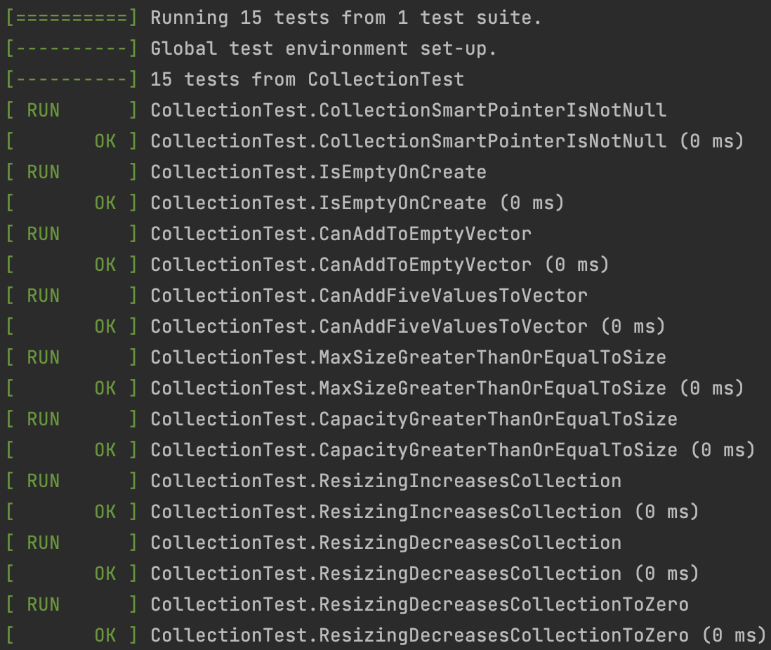
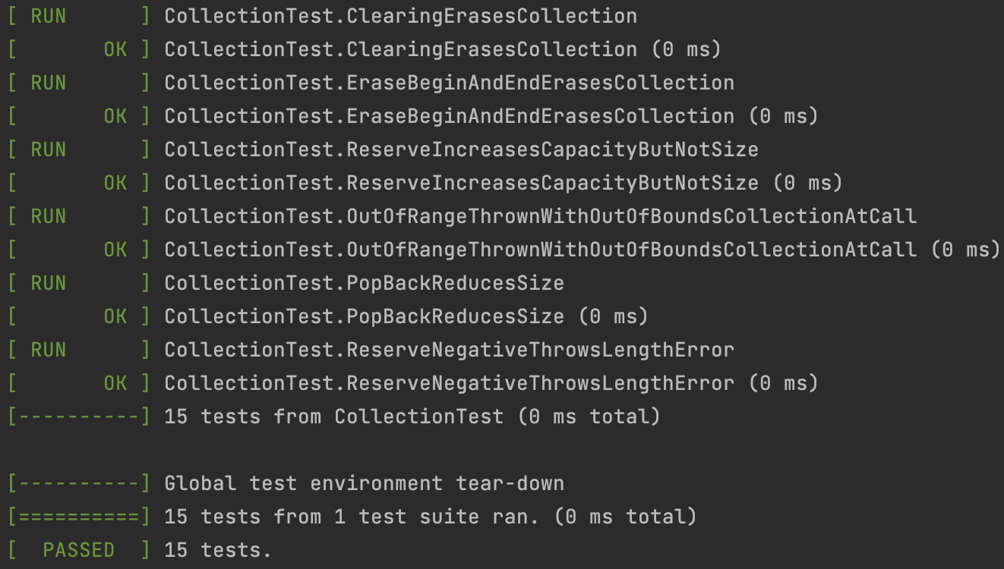
Unit Testing
I have tested numerous code vulnerabilities including methods on collections, both positive and negative.

Slide 9

AUTOMATION SUMMARY

Slide 10
TOOLS
  The DevSecOps pipeline is akin the DevOps pipeline but with extra attention paid to security through the use of various tools.
  Some external tools include the use of compiler warnings and automated secure code testing tools such as CodeSonar, Helix QAC, Astrée, and more.

Slide 11
RISKS AND BENEFITS
Determining whether to act now or to wait can be a no-brainer in many security-related situations. I would like to believe that in most cases, people do not intentionally wait to implement security solutions, but rather, miss vital, subtly holes in the code that they write which can lead to abuse later. One way to help counteract this is with the use of static code analysis tools detailed in the previous slide. If the use of these tools is delayed, it risks anyone with a keen eye of explorative mood to find and abuse an unseen vulnerability in the code. The implementation of a DevSecOps cycle is critical to the success and safety of a codebase, and further, the company.

Slide 12
RECOMMENDATIONS
    Staying on top of the latest security trends is the most critical recommendation; computer and software security is a never-ending battle between attackers and defenders that reveal new pieces of information every so often. For example, a Java package by the name “Log4J” had a security vulnerability that allowed attackers to perform remote code execution through a vulnerable protocol (Team CTO and the Division of Privacy and Identity Protection et al., 2022). Given how large-scale the package is and how it is used in many software applications around the world, it is critical to stay on top of trends like these.

Slide 13
CONCLUSIONS
All in all, the security guidelines and principles outlined within this document gives insight into the world of cybersecurity and secure coding, and an ideal explanation of actions that must be taken to ensure that Green Pace writes safe and secure code. Ensuring the safety of the code written is vital for the success of the company, as well as implementing other security policies outside of that, such as multi-factor authentication and a zero-trust policy to ensure that only employees have access to what they only need.

Slide 14
REFERENCES
Team CTO and the Division of Privacy and Identity Protection, Federal Trade Commission, &amp; Chilson, N. (2022, January 11). FTC warns companies to remediate Log4j security vulnerability. Federal Trade Commission. Retrieved October 14, 2022, from https://www.ftc.gov/policy/advocacy-research/tech-at-ftc/2022/01/ftc-warns-companies-remediate-log4j-security-vulnerability

